Slide 1
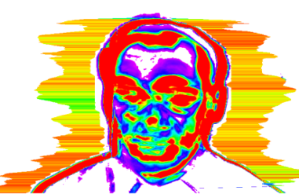
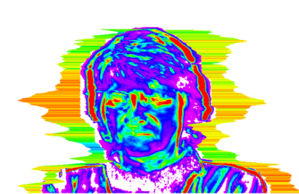
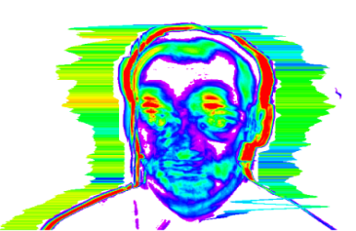
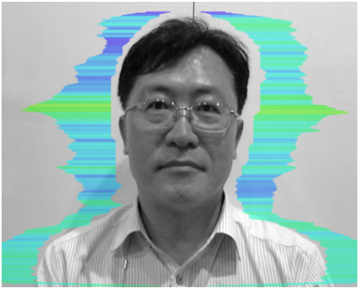
VALID PARAMETERS EXTRACTED FROM FREQUENCY CHANGES OF HEAD MOVEMENT ON STRESS STATE USING VIBRAIMAGE TECHNOLOGY
VIBRASAYSTEM

Slide 2
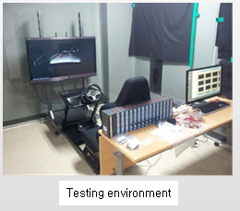
Research condition
Total teestes : 12 persons
- Male : 6 persons (32.8±5.5 age)
- Female : 6 persons (28.6±4.4 age)
Researching team :
- SANGMYUNG University
- VIBRASYSTEM
Training center : Emotion & Technology Lab in SANGMNYUNG Univ.
Experiment environment

Slide 3


Researching Objective and Testing scinario
To find out the effective parameters to make an interference of the mental
stress state observing the changes by Vibraimage technology when the cognitive stress and emotional stress are stimulated and then, to compare
the differences between the stabilized condition and stress condition.
Experiment procedure and cognitive, emotional stress stimulation
5 min
5 min
5 min
4 min
5 min
Rest | Stimuli | Rest | Stimuli | Rest
999-7= ?

Slide 4
Variations of 10 variables during stress stimulation
Variations of 10 variables during the cognitive stress stimulation
by mathematic mental arithmetic
Variations of 10 variables during the emotional stress stimulation by video image

Slide 5
Analysis Result – Cognitive stress
Analysis result of the cognitive stress stimulation by mathematic mental arithmetic
 | Kolmogorov-Smirnova |  |  | Shapiro-Wilk
 | Statistic | Degree of Freedom | Significant Probability | Statistic | Degree of Freedom | Significant Probability
Aggression | 0.127 | 22 | 0.200* | 0.954 | 22 | 0.384
Stress | 0.121 | 22 | 0.200* | 0.935 | 22 | 0.159
Tension | 0.158 | 22 | 0.163 | 0.915 | 22 | 0.059
Suspect | 0.180 | 22 | 0.063 | 0.915 | 22 | 0.061
Balance | 0.175 | 22 | 0.077 | 0.874 | 22 | 0.009
Charm | 0.161 | 22 | 0.142 | 0.913 | 22 | 0.054
Energy | 0.139 | 22 | 0.200* | 0.961 | 22 | 0.518
Self-regulation | 0.219 | 22 | 0.008 | 0.890 | 22 | 0.019
Inhibition | 0.091 | 22 | 0.200* | 0.942 | 22 | 0.213
Neutrocism | 0.130 | 22 | 0.200* | 0.941 | 22 | 0.204
* : Lower limit of positive significant probability

Slide 6
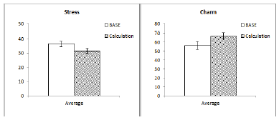
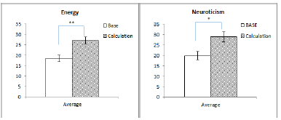
Analysis Result by experiment procedure
1. Resting state (Base)
6 variables of Aggression, Charm, Energy, Self regulation, Inhibition, Neuroticism showed
the increasing pattern, but Stress variable was decreased.
2. Comparison of statistical significance by the cognitive stress stimulation
There is the difference of increase and decrease in Stress, Charm, Self regulation variables, but the statistically effective difference was not found.(Self regulation: z= -1.215, p=.224), (Stress: t=1.766, p=.093), (Charm: t=-1.782, p=.090).
Energy and Neutrocism variables showed the statistically effective difference.(Energy: t=-3.341, p=.003), (Neuroticism: t=-2.773, p=.012)

Slide 7
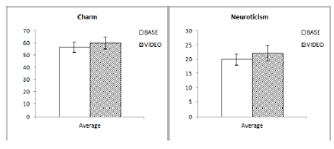
Analysis Result by experiment procedure
3. Comparison of statistical significance by the emotional stress stimulation
The emotional video stimulation showed the increasing pattern in Charm, and
Neuroticism variables.
2) There was also the difference of increase and decrease but did not show the statistically effective difference.
(Charm: t=-.517, p=.611), (Neuroticism: t= -.619, p=.543)

Slide 8
Conclusion and Discussion
Among 10 variables,
1) The most of variables showed the significant variations in the cognitive stimulation, and the statistically effective difference was shown in Energy and Neutrocism variables.
2) During the emotional stress stimulation to testees, there were the small variables with the same pattern variations and also the statistically effective difference was not found.
What are the lacking points,
The small number of subjects involved in the study, when being given the differences in degree of individual acceptance of the emotions or stress, and when the variables in the stress resistance are considered
The emotional trigger stimulations were not diverse.

